Slide 1

HTML Forms
Ranken Technical College

Slide 2
Objectives
Give an overview of HTML Forms
Explain usage of <form> element attributes
Discuss various form controls
Discuss grouping inputs with <fieldset> and <legend>
Discuss autocomplete
Build an example form

Slide 3
Forms Overview
A brief overview of HTML forms.

Slide 4
Purpose of Forms
HTML Forms allow you to collect data from the user.
For example, during user registration you might want to collect information such as:
name
email address
credit card
etc.

Slide 5
Client-Side Validation
Forms will often take input from a user and validate their input using JavaScript on the client-side.
This is done to find simple errors on the client, rather than sending bad or incorrect data to a server, only to have it returned back to the client.

Slide 6
Server-Side Validation
Normally, the form will post the validated input to a back-end application such as Node.js, ASP.NET or PHP.
The back-end application will then perform additional validation and the required processing on the posted data.

Slide 7
Form Tag
Using the HTML <form> tag.

Slide 8
<form> tag syntax
The HTML <form> tag is used to create an HTML form and it has following syntax:
<form id="myForm" action="DestinationURL" method="GET|POST">
<!-- form elements like input, select, button, etc. -->
</form>
Source
https://developer.mozilla.org/en-US/docs/Web/HTML/Element/form

Slide 9
<form> tag attributes
Attribute Description
id ID of form, used by JavaScript
action URL to process inputted data. (usually relative)
method How to upload data. Most used are GET and POST.
enctype Used to specify how the browser encodes the data.
novalidate Disables client-side validation of form.
NOTE: These are optional, but action and method should always be specified.
Source
https://developer.mozilla.org/en-US/docs/Web/HTML/Element/form

Slide 10
Form Controls
Using the HTML <input>, <output>, and <label> tags.

Slide 11
<input> tag syntax
The HTML <input> element is used to provide various interactive input controls.
Examples
<input id="fname" name="fname" type="text" class="form-control">
<input id="email" name="email" type="email" class="form-control">
<input id="age" name="age" type="number" class="form-control">
https://developer.mozilla.org/en-US/docs/Web/HTML/Element/input

Slide 12
<input> tag attributes
Attribute Description
id ID of control, used by JavaScript, not sent to server
name Name of control, sent to server
type Indicates the type of input control
class Used by CSS for styling
value Provides initial value for control
placeholder A hint that will be displayed when a value hasn't been entered
https://developer.mozilla.org/en-US/docs/Web/HTML/Element/input

Slide 13
<input> tag attributes cont.
Attribute Description
size Default width of text-input control (in characters)
minlength Min number of user input characters.
maxlength Max number of user input characters
pattern Regular expression that the input must match
min Minimum value (used for numbers and dates)
max Maximum value (used for numbers and dates)
step Increment for valid values (used for numbers)
required The value is required
readonly The value is not editable (not greyed out, kept in tab order)
disabled The form control is disabled (greyed out, removed from tab order)
autofocus The form control recieves focus when the page loads.
https://developer.mozilla.org/en-US/docs/Web/HTML/Element/input

Slide 14
<output> tag syntax
The HTML <output> element is used to display the results of a calculation
(like one performed by a script).
Example
<output id="result">60 mph</output>
https://developer.mozilla.org/en-US/docs/Web/HTML/Element/output

Slide 15
<label>
This control is used as a heading for input/output controls.
This control is required for accessibility. (screen readers)
The for attribute is required, unless the control is nested inside the label. (see below)
Clicking on a label, triggers a click event on the control.
<label for="fname">First Name</label>
<input id="fname" name="fname" type="text">
or...
<label>
First Name
<input id="fname" name="fname" type="text">
</label>
https://developer.mozilla.org/en-US/docs/Web/HTML/Element/label

Slide 16
Input Controls
Discussing various input controls.

Slide 17

Single-Line Text Input Control
This control is used for items that require only one line of user input, such as search boxes or names.
They are created using the <input> tag with types such as text, email, tel, url, password, etc.
Example HTML
<input id="fname" name="fname" type="text">
Example UI
https://developer.mozilla.org/en-US/docs/Web/HTML/Element/input
https://balsamiq.com/learn/resources/ui-control-guidelines/text-input/

Slide 18
Types of Single-Line Inputs
Type Description
text The default value. A single-line text field.
email A field for entering an email address. Looks like a text input,
but has validation parameters and relevant keyboard on touch screens.
tel A field for entering a telephone number. Displays a telephone keypad.
url A field for entering a URL. Displays a URL keyboard.
search A single-line text field for entering search strings.
Displays a search icon instead of enter key on touch screens.
https://developer.mozilla.org/en-US/docs/Web/HTML/Element/input
https://balsamiq.com/learn/resources/ui-control-guidelines/text-input/

Slide 19





Types of Single-Line Inputs cont.
Type Description
password A single-line text field whose value is obscured.
number A control for entering a number.
date A control for entering a date.
time A control for entering a time value with no time zone.
datetime A control for entering a date and time based on UTC time zone.
datetime-local A control for entering a date and time, with no time zone.
https://developer.mozilla.org/en-US/docs/Web/HTML/Element/input
https://balsamiq.com/learn/resources/ui-control-guidelines/text-input/

Slide 20

Multi-Line Text Input Control
This control is used for items that require several lines of user input, such as a comment area.
They are created using the <textarea> tag.
Example
<textarea id="comments" name="comments" rows="10" cols="50"></textarea>
https://developer.mozilla.org/en-US/docs/Web/HTML/Element/textarea
https://balsamiq.com/learn/resources/ui-control-guidelines/text-input/

Slide 21

Radio Button Control
This control is typically used for mutually exclusive selections, e.g., Male / Female, etc.
They are created using the <input type="radio"> tag.
Example
<input type="radio" name="gender" value="f"> Female
<input type="radio" name="gender" value="m"> Male
https://developer.mozilla.org/en-US/docs/Web/HTML/Element/input/radio
https://balsamiq.com/learn/resources/ui-control-guidelines/radio-buttons-checkboxes/

Slide 22

Check Box Control
This control is used for selections that are not mutually exclusive.
They are created using the <input type="checkbox"> tag.
Example
<input type="checkbox" name="topping" value="extra_cheese"> Extra Cheese
<input type="checkbox" name="topping" value="pepperoni"> Pepperoni
https://developer.mozilla.org/en-US/docs/Web/HTML/Element/input/checkbox
https://balsamiq.com/learn/resources/ui-control-guidelines/radio-buttons-checkboxes/

Slide 23

File Upload Control
This control is used to upload a file to a web site.
They are created using the <input type="file"> tag.
Example
<input id="myFile" name="myFile" type="file">
https://developer.mozilla.org/en-US/docs/Web/HTML/Element/input/file

Slide 24

Range Slider Control
This control is for entering a number whose exact value is not important.
Used with min and max attributes to define the range of acceptable values.
Example
<input type="range" min="0" max="100" step="10" value="30">
https://developer.mozilla.org/en-US/docs/Web/HTML/Element/input/range

Slide 25
Hidden Control
Used for necessary form fields that are not displayed to the user, e.g. entity IDs or confirmations codes.
They are created using the <input type="hidden"> tag.
Generally has a value attribute.
Example
<input id="productId" name="productId" type="hidden" value="30">
https://developer.mozilla.org/en-US/docs/Web/HTML/Element/input/hidden

Slide 26
Dropdown Menus
This control is typically used for selections that involve more than 3 options.
They are created using the <select> and <option> tags.
Example
<select id="vehicle_make" name="vehicle_make">
<option value="">-- MAKE --</option>
<option value="Buick">Buick</option>
<option value="Ford">Ford</option>
<option value="Volkswagon">Volkswagon</option>
</select>
https://developer.mozilla.org/en-US/docs/Web/HTML/Element/select
https://balsamiq.com/learn/resources/ui-control-guidelines/dropdown-menus/

Slide 27

List Box Control
The <select> tag can also be used to allow the user to select more than one option.
To do so, you simply add the multiple boolean attriibute.
This can be helpful when there is a large or variable number of options.
Example
<select id="toppings" name="toppings" multiple>
<option value="extra_cheese">Extra Cheese</option>
<option value="pepperoni">Pepperoni</option>
<option value="sausage">Sausage</option>
<option value="bacon">Bacon</option>
<option value="mushroom">Mushroom</option>
</select>
https://developer.mozilla.org/en-US/docs/Web/HTML/Element/select

Slide 28
Buttons
Adding buttons to your form.

Slide 29
Clickable Button Control
Used to create a button which has code associated to its click event.
They are created using either the <button> or <input> tag.
Button Tag (Preferred)
<button id="myButton" type="button">Click Me</button>
Input Tag
<input id="myButton" type="button" value="Click Me">
Source
https://developer.mozilla.org/en-US/docs/Web/HTML/Element/button
https://balsamiq.com/learn/resources/ui-control-guidelines/buttons

Slide 30
Submit Button Control
Used to create a button which submits the form to the server (may validate with JS first).
They are created using either the <button> or <input> tag.
Button Tag (Preferred)
<button type="submit">Submit</button>
Input Tag
<input type="submit" value="Submit">
Source
https://developer.mozilla.org/en-US/docs/Web/HTML/Element/button
https://balsamiq.com/learn/resources/ui-control-guidelines/buttons

Slide 31
Reset Button Control
Used to create a button which when clicked, resets form values to their defaults.
They are created using either the <button> or <input> tag.
Button Tag (Preferred)
<button type="reset">Reset</button>
Input Tag
<input type="reset" value="Reset">
Source
https://developer.mozilla.org/en-US/docs/Web/HTML/Element/button
https://balsamiq.com/learn/resources/ui-control-guidelines/buttons

Slide 32
<fieldset>
Grouping controls with <fieldset> and <legend>.

Slide 33
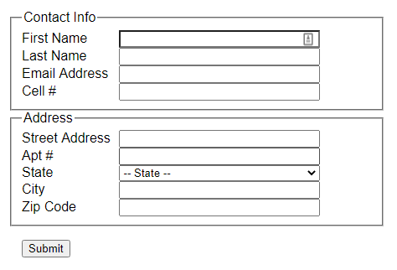
<fieldset>
The <fieldset> element can be used to group form elements.
The <legend> element is used to add a caption to the fieldset.
Example
<fieldset>
<legend>Contact Info</legend>
...
</fieldset>
<fieldset>
<legend>Address</legend>
...
</fieldset>

Slide 34
Autocomplete
Speedy data entry with autocomplete/autofill.

Slide 35
Why autocomplete?
Improved Usablity
Faster Checkout / Registration
Fewer Data Entry Errors
The browser's built-in autofill functionality needs your help to work properly. If you don't help it, it will instead cause data entry errors.
Notes:
https://webtrainingguides.com/web-development/help-users-checkout-faster-with-autofill/

Slide 36
<datalist>
<datalist> provides a list of pre-defined suggestions for an <input> element
and "autocomplete" functionality.
Example
<input type="text" list="foods" />
<datalist id="foods">
<option>Apple</option>
<option>Orange</option>
<option>Burger</option>
<option>Hot Dog</option>
<option>French Fries</option>
</datalist>
Notes:
https://developer.mozilla.org/en-US/docs/Web/HTML/Element/datalist

Slide 37
autocomplete=off|on
The autocomplete attribute can be used to change the autofill/autocomplete behavoir of an input control.
The autocomplete attribute originally only supported two values:
"on" autofill/autocomplete is enabled (default)
"off" autofill/autocomplete is disabled
NOTE: autocomplete is a suggestion to the browser, browsers have differing autofill/autocomplete behaviors and may choose to ignore your autocomplete setting.
https://developer.mozilla.org/en-US/docs/Web/HTML/Attributes/autocomplete
Notes:
https://developer.mozilla.org/en-US/docs/Web/HTML/Attributes/autocomplete

Slide 38
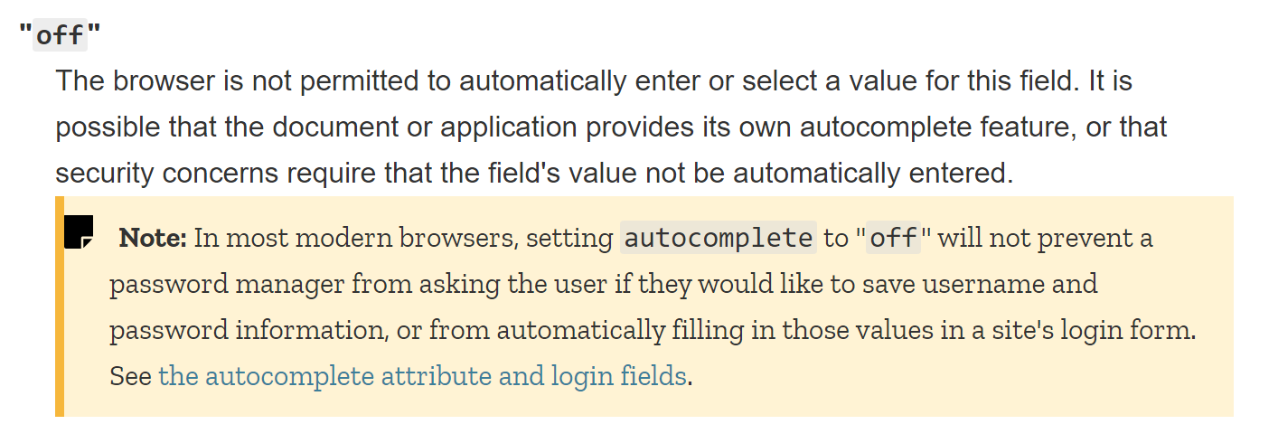
autocomplete=off
https://developer.mozilla.org/en-US/docs/Web/HTML/Attributes/autocomplete
Notes:
https://developer.mozilla.org/en-US/docs/Web/HTML/Attributes/autocomplete

Slide 39
autocomplete=...
Value Description
name The full name
given-name The given name (first name in western cultures)
additional-name The middle name
family-name The family name (last name in western cultures)
https://developer.mozilla.org/en-US/docs/Web/HTML/Attributes/autocomplete
Notes:
https://developer.mozilla.org/en-US/docs/Web/HTML/Attributes/autocomplete

Slide 40
autocomplete=...
Value Description
email An email address
username A username or account name
current-password The user's current password
new-password A new password
one-time-code A one-time code used to verify the user's identity
When creating a new account or changing passwords, "new-password" should be used for the "Enter your new password" and "Confirm new password" fields.
This may be used by the browser to avoid accidently filling an existing password and to suggest a randomized secure password.
https://developer.mozilla.org/en-US/docs/Web/HTML/Attributes/autocomplete
Notes:
https://developer.mozilla.org/en-US/docs/Web/HTML/Attributes/autocomplete

Slide 41
autocomplete=...
Value Description
country A country code
country-name A country name
address-level1 The first adminstrative level in the address.
This is typically the province in which the address is located.
In the United States, this would be the state. In Switzerland,
the canton. In the United Kingdom, the post town.
address-level2 The second adminstrative level in the address.
This is typically the city, town, or village.
address-line1 The first line of the street address.
address-line2 The second line of the street address.
(Apartment #, Studio #, PO Box, etc)
postal-code A postal code (in the United States, this is the ZIP code).
https://developer.mozilla.org/en-US/docs/Web/HTML/Attributes/autocomplete
Notes:
https://developer.mozilla.org/en-US/docs/Web/HTML/Attributes/autocomplete

Slide 42
autocomplete=...
Value Description
cc-number A credit card number.
cc-exp The expiration date of the credit card. (MM/YY or MM/YYYY)
cc-exp-month The month that the credit card expires.
cc-exp-year The year that the credit card expires.
cc-csc The security code for the credit card.
cc-name The full name as printed on the credit card.
transaction-currency The currency in which the transaction is to take place.
transaction-amount The amount of the transaction.
https://developer.mozilla.org/en-US/docs/Web/HTML/Attributes/autocomplete
Notes:
https://developer.mozilla.org/en-US/docs/Web/HTML/Attributes/autocomplete

Slide 43
autocomplete=...
Value Description
language A preferred language.
bday A birth date, as a full date.
sex A gender identity.
tel A full telephone number, including the country code.
url A URL, such as a home page or company web site.
photo A URL to an image representing the persion, company,
or contact information given in the other fields in the form.
https://developer.mozilla.org/en-US/docs/Web/HTML/Attributes/autocomplete
Notes:
https://developer.mozilla.org/en-US/docs/Web/HTML/Attributes/autocomplete

Slide 44
Example Forms
Let's build some forms!

Slide 45
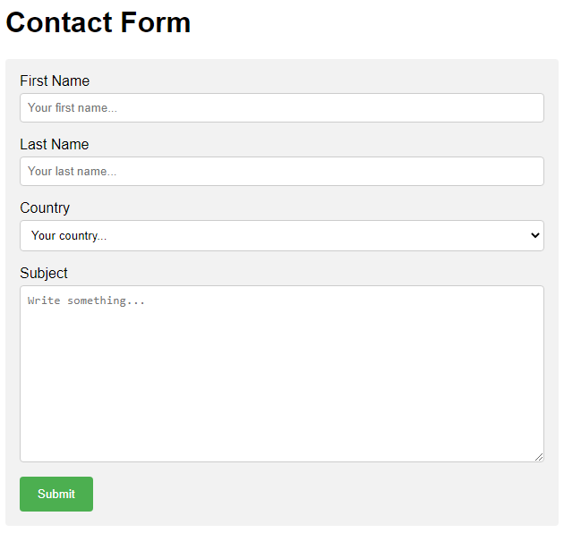
Example Form
See examples/example_form.html
in GitHub

Slide 46
Conclusion
What did we learn today?

Slide 47
What We Covered
Give an overview of HTML Forms
Explain usage of <form> element attributes
Discuss various form controls
Discuss grouping inputs with <fieldset> and <legend>
Discuss autocomplete
Build an example form

Slide 48
Some Useful URLs
HTML Web Forms Tutorial For Coding Beginners
HTML Forms Tutorial
UI Control Guidelines
MDN Docs: <form>
MDN Docs: <input>
MDN Docs: <label>
MDN Docs: autocomplete attribute

